Slide 1
NAPLAN 2023
CPS School Board Overview

Slide 2
DATA at CPS
On-Entry
PLD (Primary Literacy Development) - Spelling/Phonics and Early Reading program
Brightpath Writing/Maths
Progressive Achievement Testing (PAT) Reading/Maths
NAPLAN Yr 3&5
Teacher Judgements/Grade Allocation

Slide 3
NAPLAN Re-set
Exceeding,
Strong,
Developing
Needs additional support
These will replace the existing National Minimum Standard and the 10 NAPLAN reporting bands on Individual Student Reports.
Change in time of year
Change in reporting bands
Different Achievement Scale
Can’t view PROGRESS until 2025 (Growth)

Slide 4
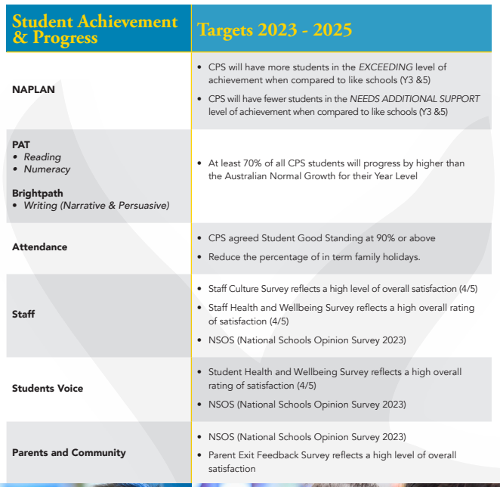
CPS Business Plan 2023-25
ACHEIVEMENT (NAPLAN)
More students in EXEEDING
Less students in NEEDS ADDITIONAL SUPPORT
GROWTH / PROGRESS (PAT/Brightpath)
- At least 70% above NATIONAL standard growth

Slide 5
CPS Business Plan 2023-25
ACHEIVEMENT (NAPLAN) - SIMPLIFIED
More students in EXEEDING
Less students in NEEDS ADDITIONAL SUPPORT
GROWTH / PRORGRESS (PAT/Brightpath)
- At least 70% above NATIONAL standard growth

Slide 6
CPS Business Plan 2023-25
ACHEIVEMENT (NAPLAN) - SIMPLIFIED
More students in EXEEDING
Less students in NEEDS ADDITIONAL SUPPORT
GROWTH / PRORGRESS (PAT/Brightpath) - ASPIRATIONAL
- At least 70% above NATIONAL standard growth

Slide 7
2023-25 CPS Business Plan – CORE TARGETS
At least 70% of all CPS students will progress by higher than the Australian Normal Growth for their Year Level
Growth
PAT
Reading
Numeracy
Brightpath
Writing (Narrative & Persuasive)
Aspirational but Achievable
70%
~65%
50-60%
2023 2024 2025

Slide 8
Why like so…
NAPLAN for ACHIEVEMENT – Compare against LIKE schools (more meaningful and aspirational)
PAT/Brightpath for GROWTH/PROGRESS – All year levels measured, continually. Can only measure against national averages.

Slide 9
PAT – Progress Reading

Slide 10
PAT Progress Numeracy

Slide 11
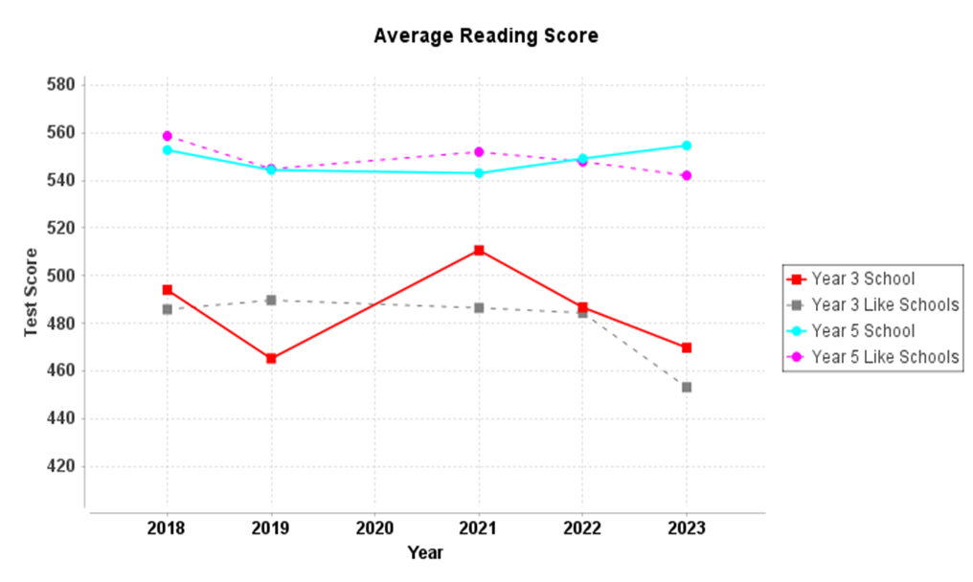
NAPLAN 2023 DATA INVESTIGATION
SAIS Dashboard
Reading
Y3 Achievement
Y3 Progress
Y5 Achievement

Slide 12
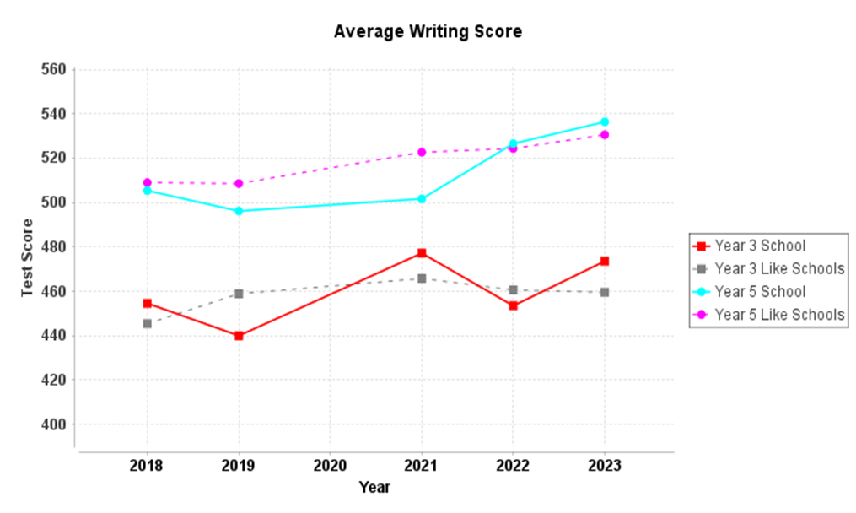
NAPLAN 2023 DATA INVESTIGATION
SAIS Dashboard
Writing
Y3 Achievement
Y5 Achievement

Slide 13
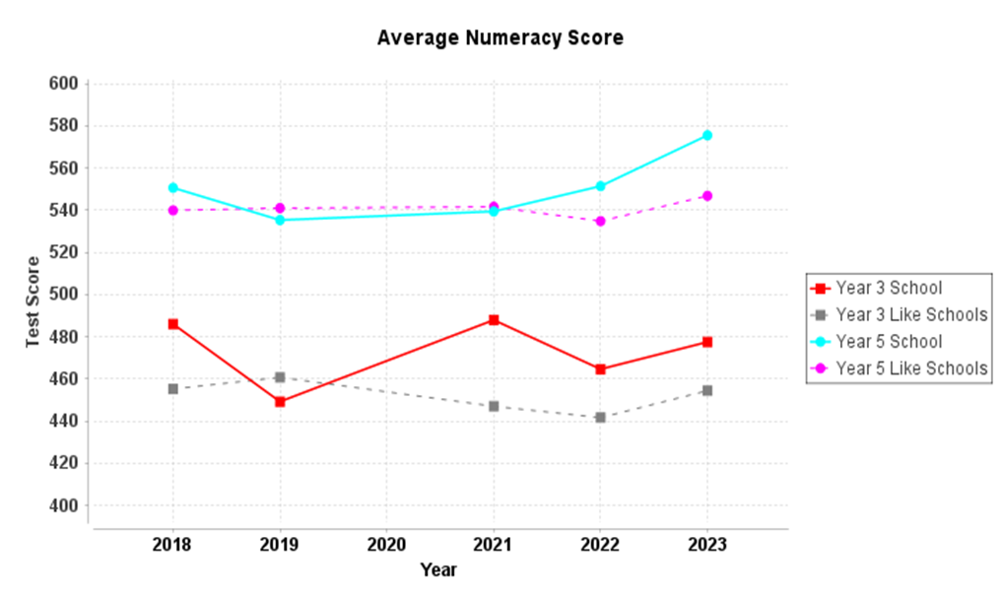
NAPLAN 2023 DATA INVESTIGATION
SAIS Dashboard
Numeracy
Y3 Achievement
Y3 Progress
Y5 Achievement

Slide 14
Business Plan 2023-2025 Student Achievement & Progress Targets NAPLAN
CPS will have more students in the EXCEEDING level of achievement when compared to like schools (Y3 &5)
 | Y3 | Y5
Reading | +10.5% | +10.3%
Writing | +6.5% | +4.2%
Numeracy | +10% | +18.5%
CPS will have fewer students in the NEEDS ADDITIONAL SUPPORT level of achievement when compared to like schools (Y3 &5)
 | Y3 | Y5
Reading | -2.4% (0) | +0.1%(1)
Writing | -1.4% (0) | +0.9%(2)
Numeracy | -2.5% (0) | -1.8%(0)

Slide 15
Business Plan 2023-2025 Student Achievement & Progress Targets ACER PAT & Brightpath
At least 70% of all CPS students will progress by higher than the Australian Normal Growth for their Year Level | At least 70% of all CPS students will progress by higher than the Australian Normal Growth for their Year Level
 |  | 2023 | 2024 | 2025
Y2 | Reading | 66%
 | Writing
 | Numeracy | 73%
Y3 | Reading | 43%
 | Writing
 | Numeracy | 65%
Y4 | Reading | 41%
 | Writing
 | Numeracy | 58%
Y5 | Reading | 48%
 | Writing
 | Numeracy | 77%
Y6 | Reading | 47%
 | Writing
 | Numeracy | 63%

Slide 16
General Curriculum Strategies
Improved Staff Data Literacy – PAT, Brightpath and NAPLAN data analysis tools
Targeted teaching – Plan, Teach, Assess model, Case Management – FOCUS ON SUPPORTING GROWTH OF ALL STUDENTS
Whole-school programs
Focus on student extension
Continue to build on intervention programs
Curriculum Leadership Team – building a collective ownership (agile teams) of curriculum strategy, that is based on authentic collaboration and researched/evidences best practice

Slide 17
Current Literacy Strategies
“Science of Reading”, PLD – re-aligning best practice for teaching reading, including assessment and student reading resources that are better suited to needs in junior years
Organising whole-school programs of learning for writing, clearly outlining the integration of literacy resources
Seven Steps for Writing
Talk 4 Writing
PLD phonics and spelling
Extending junior reading program to whole-school

Slide 18
Current Numeracy Strategies
Focus on improving student confidence, reducing cognitive load through consistent maths warm-ups. Paul Swan warm-up process.
Bond Blocks number program for lower years learning and intervention (trial 2023)
Continuing to support Maths Problem Solving

